Slide 1
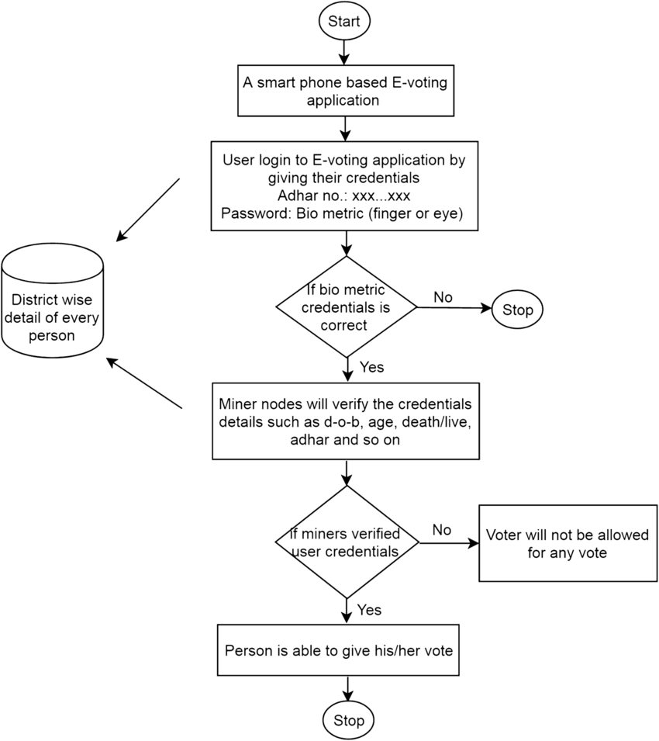
PROPOSED SYSTEM
Flow Chart :
User database

Slide 2
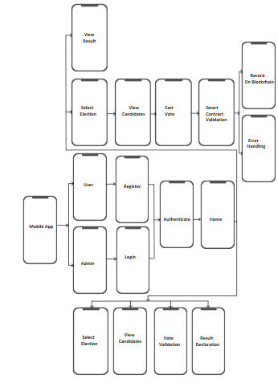
Architecture Diagram:

Slide 3
Sequence Diagram :-

Slide 4
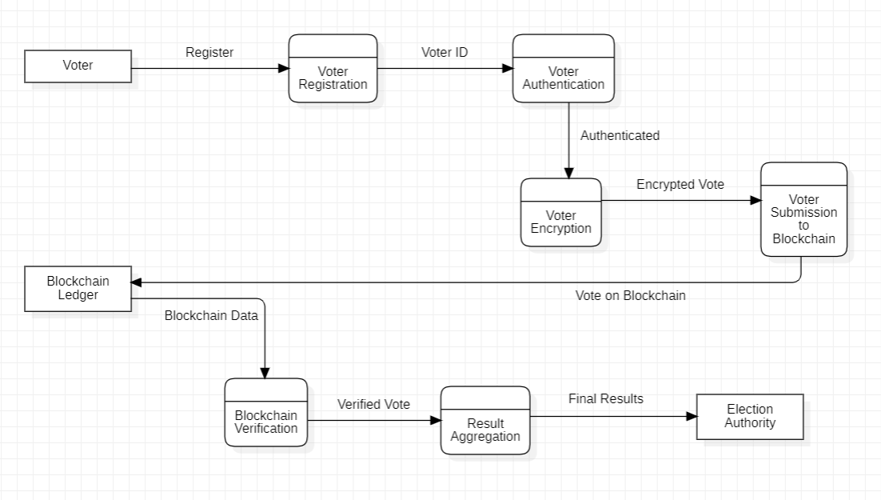
Data Flow Diagram (DFD) :-

Slide 5
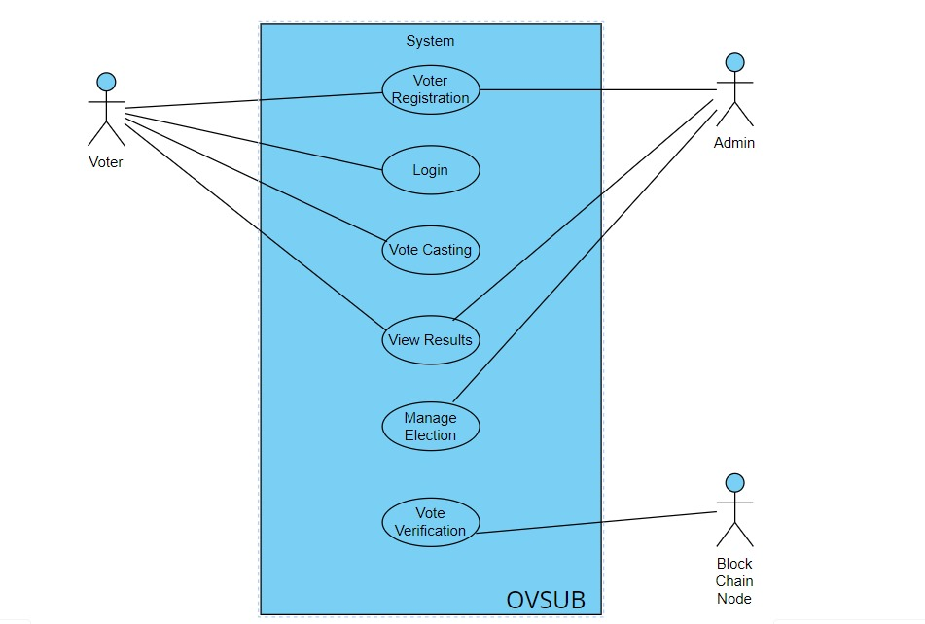
Use Case Diagram (UCD) :-

